Slide 1

Customer Behavior Analysis
Uncovering insights from 3,900 transactions to drive strategic growth

Slide 2

Key Finding: Revenue Drivers
$233K
26.67%
839
Total Revenue
Young Adults
High-Value Discount Users
Generated across all customer segments
Highest revenue contribution by age group
Customers spending above average with discounts

Slide 3

Project Objectives
Revenue Analysis
Discount Impact
Analyze spending by gender and age demographics
Understand relationship between discounts and spending
Product Performance
Customer Segmentation
Identify top products by ratings and frequency
Segment by loyalty and subscription status

Slide 4




Methodology: Tools & Process
Data Cleaning
Python in Jupyter Notebook
Data Storage
MySQL querying
Visualization
Power BI dashboards
Dataset Overview
Data Preparation
3,900 transactions analyzed
37 null values imputed
18 key features tracked
Age groups engineered
Demographics, purchases, behavior
Redundant features removed

Slide 5
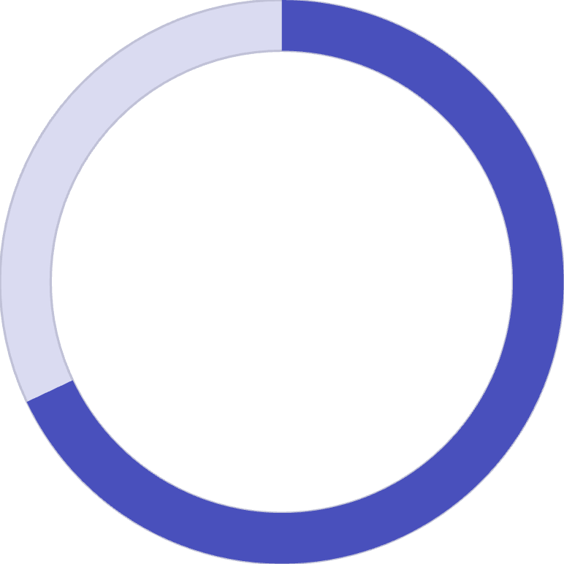
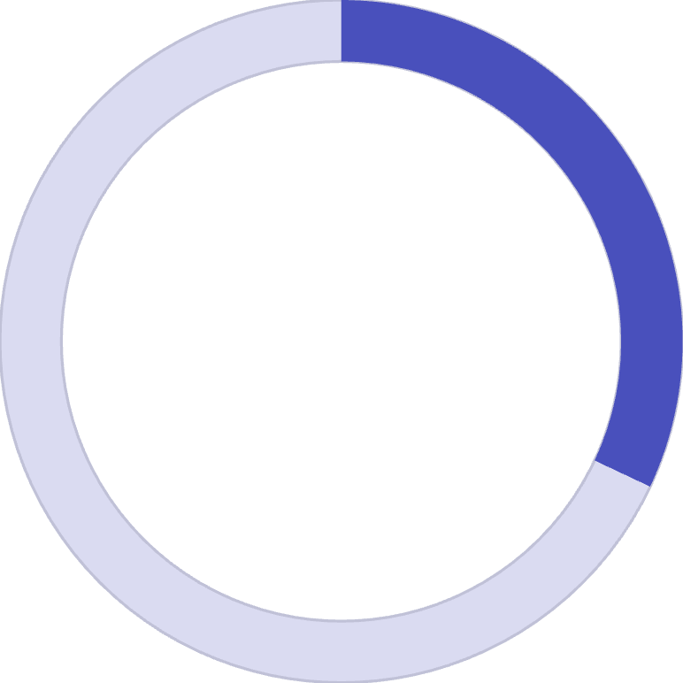
Revenue by Demographics
68%
32%
Male Revenue Share
Female Revenue Share
$157,890 total revenue from male customers
$75,191 total revenue from female customers
Young Adults Lead
Seniors Trail
26.67% of total revenue
Lowest revenue contribution
Highest contributing age segment
Opportunity for targeted campaigns

Slide 6


Discount & Shipping Insights
Express vs Standard
Top Discounted Items
Express Shipping: $60.48 average purchase
Hat - highest discount usage
Standard Shipping: $58.46 average purchase
Sneakers - promotion-driven
Coat - discount dependent
Express shippers less price-sensitive
Key Insight: 839 customers applied discounts but still spent above average, indicating discounts drive larger basket sizes

Slide 7
Top-Rated Products
1
2
3
Gloves
Sandals
Boots
3.86 average rating - highest performer
3.84 average rating
3.82 average rating
4
5
Hat
Skirt
3.80 average rating
3.79 average rating
These top-rated items represent significant opportunities for positive marketing campaigns

Slide 8



Customer Loyalty Segments
New
83 customers
Returning
701 customers
Loyal
3,116 customers
Subscriber Analysis: Subscribers generated $62,645 vs non-subscribers at $170,436. Average spend nearly identical: $59.49 vs $59.86
No significant correlation found between high repeat purchases (>5) and subscription likelihood

Slide 9
Strategic Recommendations
01
02
03
Boost Subscriptions
Enhance Loyalty Programs
Optimize Discounts
Launch targeted campaigns highlighting exclusive benefits and free shipping
Implement tiered rewards to move customers from Returning to Loyal segments
Shift to "smart" discounts (e.g., "Spend $100, get 15% off") to protect margins
04
05
Feature Top Products
Target High-Value Segments
Use top-rated items as "hero" products in marketing campaigns
Focus on Young Adults and Express Shipping customers with tailored messaging

Slide 10
Key Takeaways & Next Steps
Our strategic recommendations focus on enhancing customer loyalty and subscriptions, optimizing product and pricing strategies, and leveraging data for personalized engagement to drive sustainable growth and maximize customer lifetime value.
Thank you for your time and attention. We are confident these recommendations will drive sustainable growth and enhance customer engagement.

